Slide 1
Java Web Development basis- from Servlet To JSP
First05 chapter Servlet Session tracking

Slide 2
learning target:
After studying in this chapter, you should:
Understand what a conversation is
Understand the principle of do-it-yourself session tracking
Master the conversation object (HttpSession) Common method
Proficiently using session objects (HttpSession) to Implement session tracking
Understand the difference between a browser-side session and a server-side session
Master how to discard sessions
grasp URL Overriding method

Slide 3
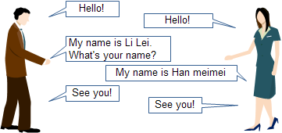
5.1 Session overview
5.1.1 What is a conversation
Conversations in daily life

Slide 4
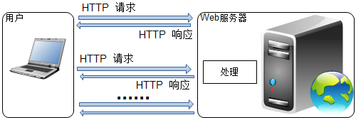
Request
Response
WEB Conversation in the application

Slide 5
What is a conversation?
You can first understand the conversation simply as follows: from the user opening the browser and sending a request to the server, until the client closes the browser or clicks the "Exit" button in the program, the continuous calling process during this period is called a session.
During the session, there may be multiple "requests——Respond to the call.

Slide 6
5.1.2 Why you need session tracking
Because HTTP protocol is a "stateless" protocol, so it is impossible to remember the user and its request. Each request is "new" to the server.
Most WEB In the application, the server must be able to track the user's session and associate the user with the user's request.
Need to use some kind of session tracking technology to remember the user and the user’s request, and the single HTTP Stateless requests are transformed into overall stateful Web application

Slide 7
5.2 commonly used session tracking technologies
The principle of session tracking technology:
When the server receives a request from a client for the first time, the server generates a unique sessionID.
The client must include this session in every subsequent requestID.
Pass this on the server side to identify which session the client's request belongs to, so as to associate the user with his series of requests.

Slide 8
5.2.1 Do it yourself to implement session tracking (using Cookies)
Cookies(PluralCookies), the Chinese name is a small text file or cookie, which refers to certain websites that are stored in the user’s local terminal in order to identify the user’s identity (Client Side) (Usually encrypted). According to the storage location in the client, it can be divided into:
  RAM Cookies hard diskCookies
Disadvantages:
Customers canDisable Cookies, You cannot pass CookiesAccess sessionID, Causing session tracking to fail.

Slide 9
5.2.1 Do it yourself to implement session tracking (using URLRewrite)
Use URLWhen rewriting to implement session tracking, you need to URLAdd the user's session to the end of ID.
Disadvantages:
1, And useCookiesSimilar, need to do a lot of repetitive operations
2, Both for all URLCoding, but also for all points to your websiteURLFor coding, it is also required that all pages must be dynamically generated.

Slide 10
5.2.1 Do it yourself to implement session tracking (hidden form fields)
The principle is to use a form, set hidden fields in the form, and pass the conversation through the hidden fieldsID. E.g:
<input type="hidden" name="jsessionid" value="1234abcd">
Disadvantages: not all pages have forms, so the whole can not be completed in this way.

Slide 11
5.2.2 use ServletSession tracking provided API (HttpSession)
Servlet Container will create HttpSession object. In HttpSession The client's session can be accessed in the objectID Or other information to complete the session tracking task.
The underlying implementation is based on Cookies or URLRewrite technology
when the client allows use Cookies, Use first Cookies Conversation tracking
if the client is disabled Cookies, choose to use URLRewrite.

Slide 12
5.3 Session interface (HttpSession) Common methods and examples
getSession()withgetSession(boolean create). For the convenience of presentation, the method with parameters is divided into two rows in the following table according to different values, and they are described separately.
Method name | Return value type | Applicable situation
getSession() | HttpSession | Return the session object related to the current request; if the session does not exist, create one
getSession(true) | HttpSession | Usage andrequest.geSession()the same
getSession(false) | HttpSession | Return the session object related to the current request; if the session does not exist, return null
getId() | String | Returns the server assigned to the sessionID

Slide 13
Goal: learn to use HttpSession Object, access the session object associated with the current request
Construction name:Example0501
Files used:
file name | Description
index.jsp | Simply rewrite the files that are automatically created when the project is created. The page used by the customer to submit information includes a form with a text field and a submit button, and the information is submitted toSessionServlet1.
SessionServlet1 | Manually createdServletTo getindex.jspInformation submitted by users of the page and displayed in the form of a web page. at thisServletVisit the session associated with the current request and display the sessionID; In addition, output a hyperlink, which links toSessionServlet2.
SessionServlet2 | Manually createdServletTo get the session associated with the current request and display the sessionID; Try to passrequest.getParameter(String name)Method to obtainindex.jspInformation submitted.

Slide 14
index.jsp
<body>
<form action="SessionServlet1" method="POST">
  What I want to say:<input type="text" name="msg" value="" />
  <input type="submit" value="submit"/>
</form>
</body>

Slide 15
SessionServlet1.java
protected void processRequest(HttpServletRequest request, HttpServletResponse response)
throws ServletException, IOException {
  response.setContentType("text/html;charset=UTF-8");
  PrintWriter out = response.getWriter();
try {
  //Obtain and output the information submitted by the user
  String mymsg = request.getParameter("msg");
  out.print(mymsg);
  //Change line
  out.print("<br/>");
  //Access the session object associated with the current request, if it does not exist, create one
  HttpSession mySession=request.getSession();
  String sessionId=mySession.getId();
  out.print(sessionId);
  //Change line
  out.print("<br/>");
  //Output hyperlink, pay attentionhrefDouble quotes for attribute values""Need to be escaped
  out.print("<a href=\"SessionServlet2\">connected toSessionServlet2</a>");
} finally {out.close();}
}

Slide 16
SessionServlet2.java
protected void processRequest(HttpServletRequest request, HttpServletResponse response)
throws ServletException, IOException {
response.setContentType("text/html;charset=UTF-8");
PrintWriter out = response.getWriter();
try {
  //Obtain and output the information submitted by the user
  String mymsg = request.getParameter("msg");
  out.print(mymsg);
  //Change line
  out.print("<br/>");
  //Access the session object associated with the current request, if it does not exist, create one
  HttpSession mySession = request.getSession();
  String sessionId=mySession.getId();
  out.print(sessionId);
} finally {out.close();}
}

Slide 17
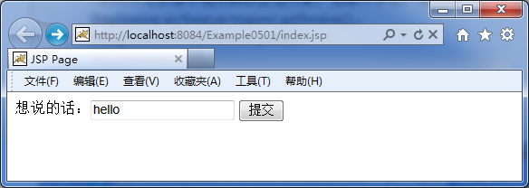
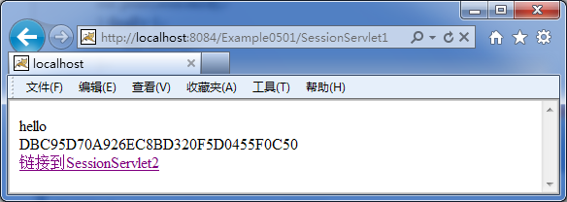
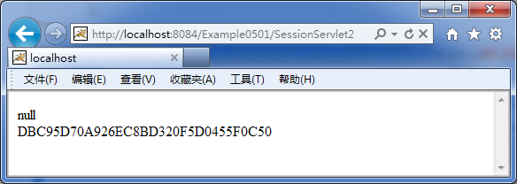
in conclusion:
the same customerRegardless of what is experienced during the conversation get Request or post request,HttpSession Objects can achieve session tracking tasks
Obtain and output the information submitted by the customer twice, the first time was successfully taken out, and the second time was null,Verified HTTP protocol is a "stateless" protocol and cannot span multiple requests.

Slide 18
5.3.2 Store, read, and remove information in the session object
setAttribute(String name,Object value)
getAttribute(String name)
removeAttribute(String name)
Method name | Return value type | Applicable situation
setAttribute(String name,Object value) | void | Bind an object to the current session and become one of its attributes. If the attribute already exists, replace the previous object with the new object.
getAttribute(String name) | Object | Get the object bound to the specified attribute from the current object, and return if the attribute name does not existnull.
removeAttribute(String name) | HttpSession | Remove the object bound by the specified property, if the property does not exist, do nothing

Slide 19
Goal: learn to useHttpSessionObject, save, read, and remove information in the session object
Construction name:Example0502
Files used:
file name | Description
index.jsp | Simply rewrite the files automatically created when the project is created. The page used by the customer to submit information includes a form with a text field and a submit button, and the information is submitted toSessionServlet1.
SessionServlet1 | Manually createdServletTo getindex.jspInformation submitted by users of the page and displayed in the form of a web page. at thisServletAccess the session associated with the current request, save the information submitted by the user into the session object, and display the sessionID; In addition, output a hyperlink, which links toSessionServlet2.
SessionServlet2 | Manually createdServlet, Used to obtain the session associated with the current request, read the previously stored information from the session object, output the information and display the sessionID. In addition, output a hyperlink that links toSessionServlet3.
SessionServlet3 | Manually createdServlet, Used to get the session associated with the current request and remove the previously saved information. Read the stored information again and output the information, and finally display the conversationID;.

Slide 20
index.jsp
<body>
  <form action="SessionServlet1" method="POST">
  What I want to say:<input type="text" name="msg" value="" />
  <input type="submit" value="submit"/>
  </form>
</body>

Slide 21
SessionServlet1.java
protected void processRequest(HttpServletRequest request, HttpServletResponse response)
throws ServletException, IOException {
response.setContentType("text/html;charset=UTF-8");
PrintWriter out = response.getWriter();
try {
  //Obtain and output the information submitted by the user
  String mymsg = request.getParameter("msg");
  out.print(mymsg);
  //Change line
  out.print("<br/>");
  //Access the session object associated with the current request, if it does not exist, create one
  HttpSession mySession=request.getSession();
  //Information submitted by usersmymsgThis value (value) TomsgThis name (key) Save to the session object
  mySession.setAttribute("msg", mymsg);
  String sessionId=mySession.getId();
  out.print(sessionId);
  //Change line
  out.print("<br/>");
  //Output hyperlink, pay attentionhrefDouble quotes for attribute values"Need to be escaped
  out.print("<a href=\"SessionServlet2\">connected toSessionServlet2</a>");
} finally {out.close();}
}

Slide 22
SessionServlet2.java
protected void processRequest(HttpServletRequest request, HttpServletResponse response)
throws ServletException, IOException {
response.setContentType("text/html;charset=UTF-8");
PrintWriter out = response.getWriter();
try {
  //Access the session object associated with the current request, if it does not exist, create one
  HttpSession mySession = request.getSession();
  //Retrieve the name from the session object (key)formsgObject and cast toStringTypes of
  String mymsg = (String) mySession.getAttribute("msg");
  out.print(mymsg);
  //Change line
  out.print("<br/>");
  String sessionId = mySession.getId();
  out.print(sessionId);
  //Output hyperlink, link toSessionServlet3,notehrefDouble quotes for attribute values"Need to be escaped
  out.print("<a href=\"SessionServlet3\">Remove information</a>");
} finally {out.close();}
}

Slide 23
SessionServlet3.java
protected void processRequest(HttpServletRequest request, HttpServletResponse response)
throws ServletException, IOException {
response.setContentType("text/html;charset=UTF-8");
PrintWriter out = response.getWriter();
try {
  //Access the session object associated with the current request, if it does not exist, create one
  HttpSession mySession = request.getSession();
  //Remove the name from the session object (key)formsgObject
  mySession.removeAttribute("msg");
  //Retrieve the name from the session object (key)formsgObject and cast toStringTypes of
  String mymsg = (String) mySession.getAttribute("msg");
  out.print(mymsg);
  //Change line
  out.print("<br/>");
  String sessionId = mySession.getId();
  out.print(sessionId);
} finally {out.close();}
}

Slide 24
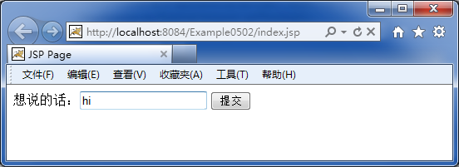
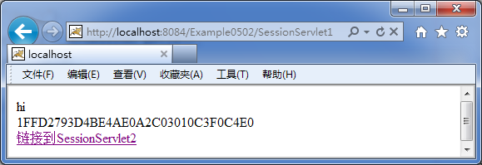
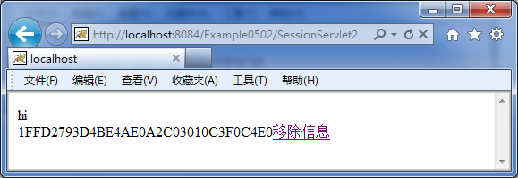
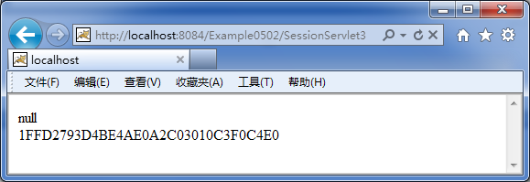
in conclusion:
Three times ID Same, proves to be the same customer, is the sameHttpSessionObject
HttpSessionObject of setAttribute (String name,Object value)Methods can store data in the session object
HttpSessionObject of getAttribute (String name)Methods can read data from the session object
HttpSessionObject of removeAttr ibute(String name)Methods can remove data from the session object
HttpSessionThe object can span multiple requests. Before the session object is destroyed, as long as the information is not removed, the data stored in the session object can be shared by multiple requests from the same client

Slide 25
5.3.3 The difference between a browser session and a server session
By default, session tracking is based on the memory stored in the browser cookie, Unless you write the program to actively cookieSave it on the client’s hard disk, otherwise close the browser’s memory by default.cookieWill disappear, causing session tracking to fail. This is Browser session.
For session tracking, inThe server side needs to maintain the session object in the server's memory.
When the browser is closed, the browser-side session ends, but the server-side still needs to maintain the session object until a certain agreed time interval is reached.

Slide 26
5.3.4 Abandoned session
Abandoned sessions can be divided into passive and active methods.
Passive way-set the session timeout
Active way-call invalidate()method

Slide 27
Passive way——Set the session timeout period
There are three ways to set the session timeout period, among which:
Mode 1 has the highest priority, Mode 2 has the highest priority, Mode 3 has the lowest priority
Method 1: After accessing the session object, call its setMaxInactiveInterval(int interval)method
For example: if the session timeout period is set to30Minutes, the code is
HttpSession session = request.getSession();
session.setMaxInactiveInterval(1800);//Unit is second

Slide 28
Passive way——Set the session timeout period
Method two: inwebApplication configuration file web.xml Middle setting<session-config>
For example: if the session timeout period is set to30 Minutes, the code is
<session-config>
  <session-timeout>30</session-timeout>
</session-config>

Slide 29
Passive way——Set the session timeout period
Method three: inTomcatInstallation directoryconfConfiguration files under the directoryweb.xmlMiddle setting<session-config>
For example: if the session timeout period is set to30Minutes, the code is
<session-config>
  <session-timeout>30</session-timeout>
</session-config>

Slide 30
Active way-call invalidate() method
Goal: learn to useinvalidate()Method, discard the session (unbind).
Construction name:Example0503
Files used:
file name | Description
SessionServlet | Manually createdServlet. at thisServletFirst visit the session associated with the current request, and output the sessionID; Next call invalidate()Method; finally visit the session associated with the current request again, and output the sessionID.

Slide 31
SessionServlet.java
protected void processRequest(HttpServletRequest request, HttpServletResponse response)
throws ServletException, IOException {
response.setContentType("text/html;charset=UTF-8");
PrintWriter out = response.getWriter();
try {
  //Access the session object associated with the current request, if it does not exist, create one
  HttpSession session1 = request.getSession();
  //Output sessionID
  out.print(session1.getId());
  //transferinvalidate()Method, unbind, and discard the session.
  session1.invalidate();
  //Change line
  out.print("<br/>");
  //Visit the session object associated with the current request again, if it does not exist, create one
  HttpSession session2 = request.getSession();
  //Output sessionID
  out.print(session2.getId());
} finally {out.close();}
}

Slide 32
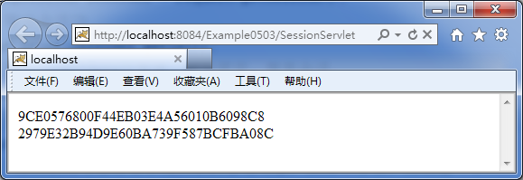
Two output sessions ID are Different, proof After call invalidate() the method, the previous session has been discarded.

Slide 33
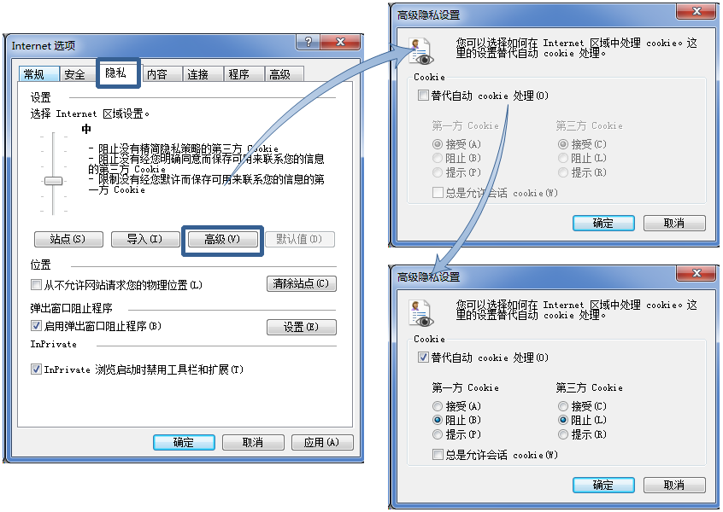
5.4 use HttpResponse Object built-in method implementation URLRewrite
First block through privacy settings CookiesAnd re-runExample0502example of

Slide 34
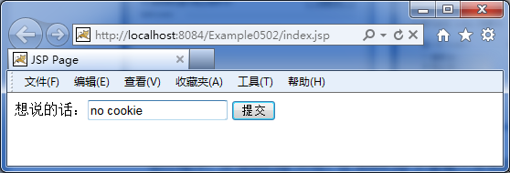
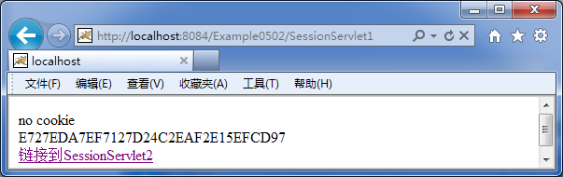
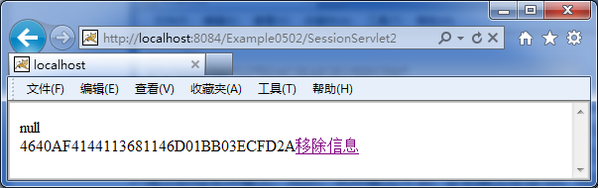
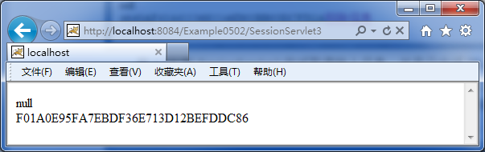
You can see each output Different sessionID, After stopCookies the session tracking failed!

Slide 35
Use URLRewrite the way to achieve session tracking
Principle: Will sessionID Attached as a parameter URLBehind. useHttpServletResponseThe built-in methods of the object are implemented.
HttpServletResponse Object of encodeURL or encodeRedirectURL to implement URL Rewrite。
这两个方法首先判断Cookies是否被浏览器支持；如果支持，则参数URL被原样返回，session ID将通过Cookies来维持。否则返回带有sessionID的URL。

Slide 36
HttpResponse对象实现会话跟踪的2个方法
方法名 | 返回值类型 | 适用情况
encodeURL(String url) | String | 通过将会话 ID 包含在指定 URL 中对该 URL 进行编码，如果不需要编码，则返回未更改的 URL。此方法的实现包含可以确定会话 ID 是否需要在 URL 中编码的逻辑。例如，如果浏览器支持 cookie，或者关闭了会话跟踪，则 URL 编码就不是必需的。对于健壮的会话跟踪，servlet 发出的所有 URL 都应该通过此方法运行。否则，URL 重写不能用于不支持 cookie 的浏览器。
encodeRedirectURL(String url) | String | 对指定 URL 进行编码，以便在 sendRedirect 方法中使用它，如果不需要编码，则返回未更改的 URL。此方法的实现包含可以确定会话 ID 是否需要在 URL 中编码的逻辑。因为进行此确定的规则可能不同于用来确定是否对普通链接进行编码的规则，所以此方法与 encodeURL 方法是分开的。 发送到 HttpServletResponse.sendRedirect 方法的所有 URL 都应该通过此方法运行。否则，URL 重写不能用于不支持 cookie 的浏览器。

Slide 37
目标：学习使用HttpServletResponse对象内建方法实现URL重写
工程名：Example0504
在Example0502的基础上做修改得到，或者新建工程后将Example0502相关代码复制粘贴过来。只需要改超级链接的href属性或者表单的action属性即可。例如在SessionServlet1中，只需要将代码
out.print("<a href=\"SessionServlet2\">链接到SessionServlet2</a>");
改为
String url=response.encodeURL("SessionServlet2");
out.print("<a href=\""+url+"\">链接到SessionServlet2</a>");
在SessionServlet2中，只需要将代码
out.print("<a href=\"SessionServlet3\">移除信息</a>");
改为
String url=response.encodeURL("SessionServlet3");
out.print("<a href=\""+url+"\">移除信息</a>");

Slide 38
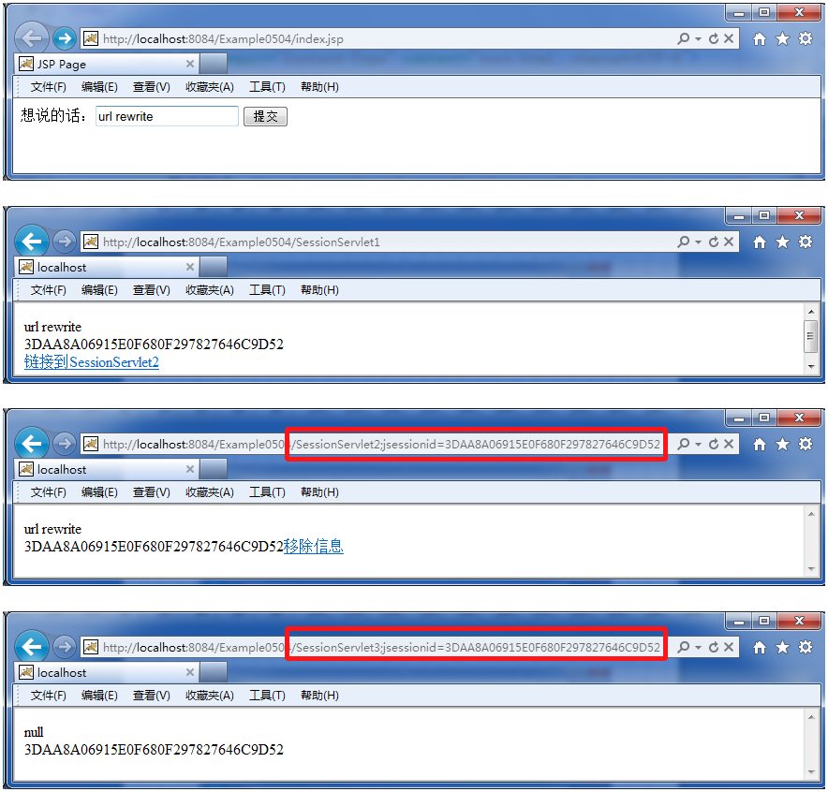
URL重写之后的会话跟踪，成功！

Slide 39
课后习题
[1].独立完成本章所有示例。
[2].常用的会话跟踪技术有哪些？试简要介绍各个技术的基本原理。
[3].如何访问与当前请求相关联的会话对象？这些方法有什么差别？
[4].通过会话对象的什么方法能够在会话中存入、读取、移除信息？
[5].浏览器会话与服务器会话有什么区别？
[6].什么是URL重写？如何实现URL重写？
[7].尝试使用会话对象实现一个购物车
[8].尝试使用会话对象，模拟如下效果：当用户登录网站后，访问该网站任何链接，页面上均可显示如下文字“欢迎您，xxx”xxx为用户登录名。

